Slide 1

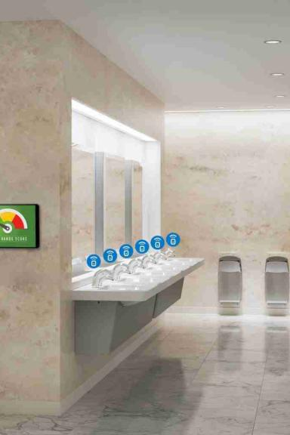

Smart Public Restrooms: Revolutionizing the User Experience
Discover how smart public restrooms are transforming traditional facilities into advanced spaces that prioritize convenience, hygiene, and sustainability.
By ELAVARASI NISHA RANI

Slide 2

What is a Smart Public Restroom?
Explore the concept of smart public restrooms and how they leverage technology to enhance user comfort, improve cleanliness, and optimize maintenance operations.

Slide 3

Importance of Smart Public Restrooms
1
Hygiene & Safety 🧼
Efficient cleaning systems and touchless fixtures minimize the spread of germs and ensure a safe restroom environment.
2
User Satisfaction 😄
Smart restrooms provide pleasant experiences through automated features, such as occupancy sensors and intuitive interfaces.
3
Sustainability ♻️
Innovative technologies reduce water consumption, promote energy efficiency, and contribute to eco-friendly practices.

Slide 4
Feature Engineering
Identifying Relevant Features
Data Collection and Preprocessing
Analyze user behavior and requirements to determine the features necessary for creating a seamless restroom experience.
Gather data from sensors and user feedback, ensuring its quality and transforming it into a format suitable for analysis.

Slide 5

Model Training
1
Choosing Appropriate Machine Learning Algorithms
Select algorithms tailored to analyze restroom data, such as occupancy patterns and asset maintenance needs.
2
Training the Models with the Preprocessed Data
Utilize the preprocessed data to train machine learning models that can predict usage patterns and optimize maintenance schedules.
3
Evaluation
Assess the performance of the trained models using relevant evaluation metrics to validate their effectiveness in optimizing restroom operations.

Slide 6

Future Developments and Challenges
Potential Improvements for Smart Public Restrooms
Addressing Challenges in Implementing Smart Public Restrooms
Explore possibilities for further enhancing restroom functionality, such as incorporating AI for personalized user experiences.
Discuss the obstacles faced when integrating technology into public facilities and propose strategies to overcome them.

Slide 7
Conclusion
By embracing smart technologies, public restrooms can revolutionize user experiences, prioritize hygiene, and contribute to a sustainable future for all.

